Slide 1


ENERGY POLICY
owerview and main aspects
Slovak Republic
„International approach to smart energy solutions“

Slide 2
ENERGY POLICY
Slovak Republic
Energy policy is the manner in which a given entity (often governmental) has decided
to address issues of energy development including energy conversion, distribution
and use as well as reduction of greenhouse gas emissions in order to contribute to
climate change mitigation.

Slide 3
ENERGY POLICY
Slovak Republic
Since the 2012 in-depth review, the Slovak Republic has made significant progress on several fronts of energy policy. Together with its neighbours, the Slovak Republic has strengthened cross-border connections for electricity, natural gas and oil. This has served both to improve energy security and increase market competition.
The government has also set targets for energy efficiency and renewable energy, and the latter go beyond the country’s European Union (EU) targets. The International Energy Agency (IEA) congratulates the government for making clear progress to meet these targets. Energy efficiency is improving, the share of renewable energy is increasing, and energy-related carbon dioxide (CO₂) emissions are declining.

Slide 4
ENERGY POLICY
Slovak Republic
Oil and gas security has improved
Low-carbon electricity system is expanding
Focus area: The heat sector
CO₂ emissions from energy use need to be further limited

Slide 5
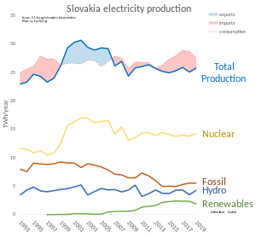
ENERGY POLICY
Slovak Republic

Slide 6
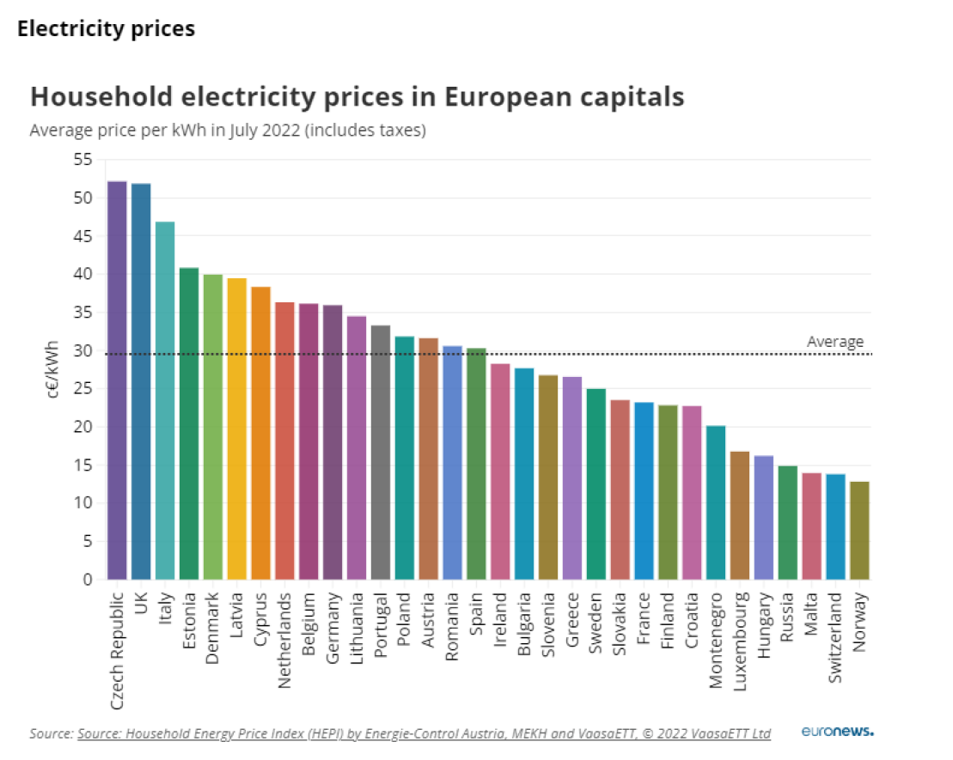
COMPARING PRICES for ELECTRICITY in EUROPEAN COUNTRIES
In 2022

Slide 7
ENERGY POLICY
Slovak Republic
The Slovak Republic’s energy system is characterised by a high share of nuclear power, which accounts for 75% of domestic energy production and the largest part of the total primary energy supply (TPES)² (Figure 2.2). Domestic nuclear energy production helps improve energy security in the Slovak Republic, which otherwise is dependent on large fossil fuel imports, mainly from the Russian Federation

Slide 8
Howto reduce energy consumption at domestic installation
Slovak national average home electricity consumption is about 1000 kWh/month. Using more, even greater savings may be possible.
There are many ways you can reduce electricity use in our home:
Appliances and electronics -- Purchasing energy-efficient products and operate them efficiently. Useing an advanced power strip to reduce "vampire loads"--electricity that is wasted when electronics are not in use.
Lighting -- Purchase energy-efficient products, operate them efficiently, and incorporate more daylighting into your home using energy-efficient windows and skylights.
Electric space heating and cooling -- Purchase energy-efficient electric systems and operate them efficiently. Incorporate passive solar design concepts into your home, which include using energy-efficient windows. Properly insulate and air seal your home. Select an energy-efficient heating system that doesn't use electricity.
Electric water heating -- Purchase an heat pump water heater and operate it efficiently.
Reduce your “always-on” appliances. If your home has a smart meter and you can see your hourly consumption, then examine your consumption at 3AM. It should be significantly less than your use at 7pm. If it isn’t then you might have “vampire loads.”. Look for electronics that you don’t use (like DVDs!) or can switch off, or perhaps get rid of that extra refrigerator.

Slide 9
The energy saving tips below give you some tools and tactics that will help you save gas and electricity at home.
1. Turn off standby appliances
Turn appliances off at the plug to save an average of 30EUR a year.
Use plug sockets that can be turned on and off via your phone, to make sure you switch unused appliances off. You could use cheaper timer plugs to schedule turning appliances off.
2. Install a smart thermostat
Smart thermostats can make your heating more efficient by only warming the rooms you are using.
They learn how long it takes to heat your home, so they can have it at the right temperature at exactly the right time.
They can also be controlled by your phone, which means you won?t have to come back to a cold home.
If you installed room thermostats, programmers and thermostatic radiator valves, you could save around 75EUR a year.

Slide 10
Howto reduce energy consumption at domestic installation
3. Turn down your thermostat
Almost half the money spent on energy bills is absorbed by heating and hot water costs.
Turning your heating down by just one degree could save up to £80 a year.
4. Buy efficient appliances
Throwing out a perfectly good appliance won?t save you much money, but when it is time to swap, going for one with a high energy-efficiency rating can be worth the investment.
An A+++ washing will typically use 65EUR less energy than an A+ one over an 11-year product lifespan.
A modern, efficient dishwasher will typically cost around 7EUR less a year to run compared to an older model.
An A+++ fridge freezer will save around EUR320 in energy bills over its lifetime compared to an A+ model.
5. Install a new boiler
You can save energy by upgrading your old boiler to a new A-rated condensing boiler with a programmer, room thermostat and thermostatic radiator controls.
Based on fuel prices in March 2019, a detached house upgrading from a G-rated boiler could save around EUR300 a year.
6. Wash clothes at a lower temperature
Washing at 30 degrees rather than 40 degrees can help reduce your energy usage, and if you can cut out one wash cycle per week you’ll clip 50EUR off your annual energy bill.

Slide 11
Howto reduce energy consumption at domestic conditions
7. Be smarter about water
You can save around 25EUR a year by washing up in a bowl rather than using a running tap.
Buying a more efficient shower head can save you as much as 18EUR per person a year on energy bills, plus an additional amount if you have a water meter.
If you fit a shower timer in your bathroom, you could save up to 8EUR per person each year by cutting just one minute off every shower.
8. Invest in double glazing
Double glazing insulates your home from the cold and helps reduce your heating bill, as well as keeping the noise out.
If your semi-detached home is entirely single glazed, you could save as much as 110EUR a year by installing A-rated double glazing.
9. Draught-proof your property
A cold draught can cause your home to lose heat, which makes it more tempting to turn the heating up. Draught excluders or draught-proofing kits are a good way to prevent this.
Seal cracks in floors and skirting boards, line your letterbox and block an unused chimney to reduce your heating bills by up to 35EUR a year.
If you don't have double glazing, you can buy plastic lining for your windows to save energy and keep more heat in.

Slide 12
Howto reduce energy consumption at domestic conditions
10. Insulate the roof
Insulating your roof can stop heat escaping from your home ? however the process can be complicated so it may be best to employ an expert to do this.
While insulating your loft can cost several hundreds of EUR , it can also shave around 135EUR off your energy bills each year if you live in a typical house.
11. Monitor your usage
Keeping a watchful eye on your consumption levels can help you decide if and when you have to change the way you use energy.
Installing a Smart Meter lets you track your consumption with accurate and real time information.
This project has been funded with support from the European Commission under the Erasmus+ Programme. This publication reflects the views only of the author, and the Commission cannot be held responsible for any use which may be made of the information contained therein.

